Slide 1
EMBED/NETRF: The Magic Mirror
Simon Aerts
Jordi Jaspers

Slide 2
Table Of Contents
Introduction
(Aanvullen)
References

Slide 3
Software
Raspberry Pi
Node js -> Mirror application
Python -> button events
ESP32
Arduino C/C++

Slide 4
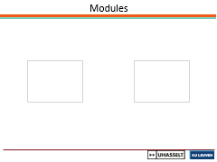
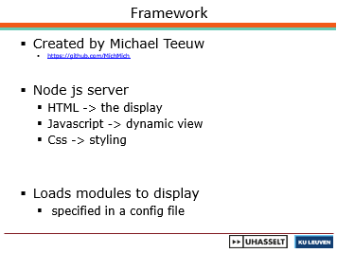
Mirror application

Slide 5
Framework
Created by Michael Teeuw
https://github.com/MichMich
Node js server
HTML -> the display
Javascript -> dynamic view
Css -> styling
Loads modules to display
specified in a config file

Slide 6
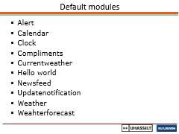
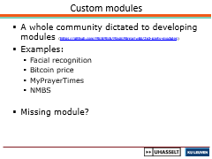
Modules

Slide 7
Default modules
Alert
Calendar
Clock
Compliments
Currentweather
Hello world
Newsfeed
Updatenotification
Weather
Weahterforecast

Slide 8
Custom modules
A whole community dictated to developing modules (https://github.com/MichMich/MagicMirror/wiki/3rd-party-modules)
Examples:
Facial recognition
Bitcoin price
MyPrayerTimes
NMBS
Missing module?

Slide 9
Self-made modules
Control RGB light
Show the RGB light
Display a value send by the ESP32

Slide 10
Create your own modules

Slide 11
References
[1] | Dr. Steven Lawrence Fernandes, Tim Cox (2018). Raspberry Pi 3 Cookbook for Python Programmers.

